Slide 1

Home
Recycler
Municipality
Shop

Slide 2
Home
Recycler
Municipality
Shop
Register
Register
Register
Deposit
Assign
Redeem
Spend
Spend
Home
Recycler
Municipality
Shop

Slide 3
Home
Recycler
Municipality
Shop

Slide 4

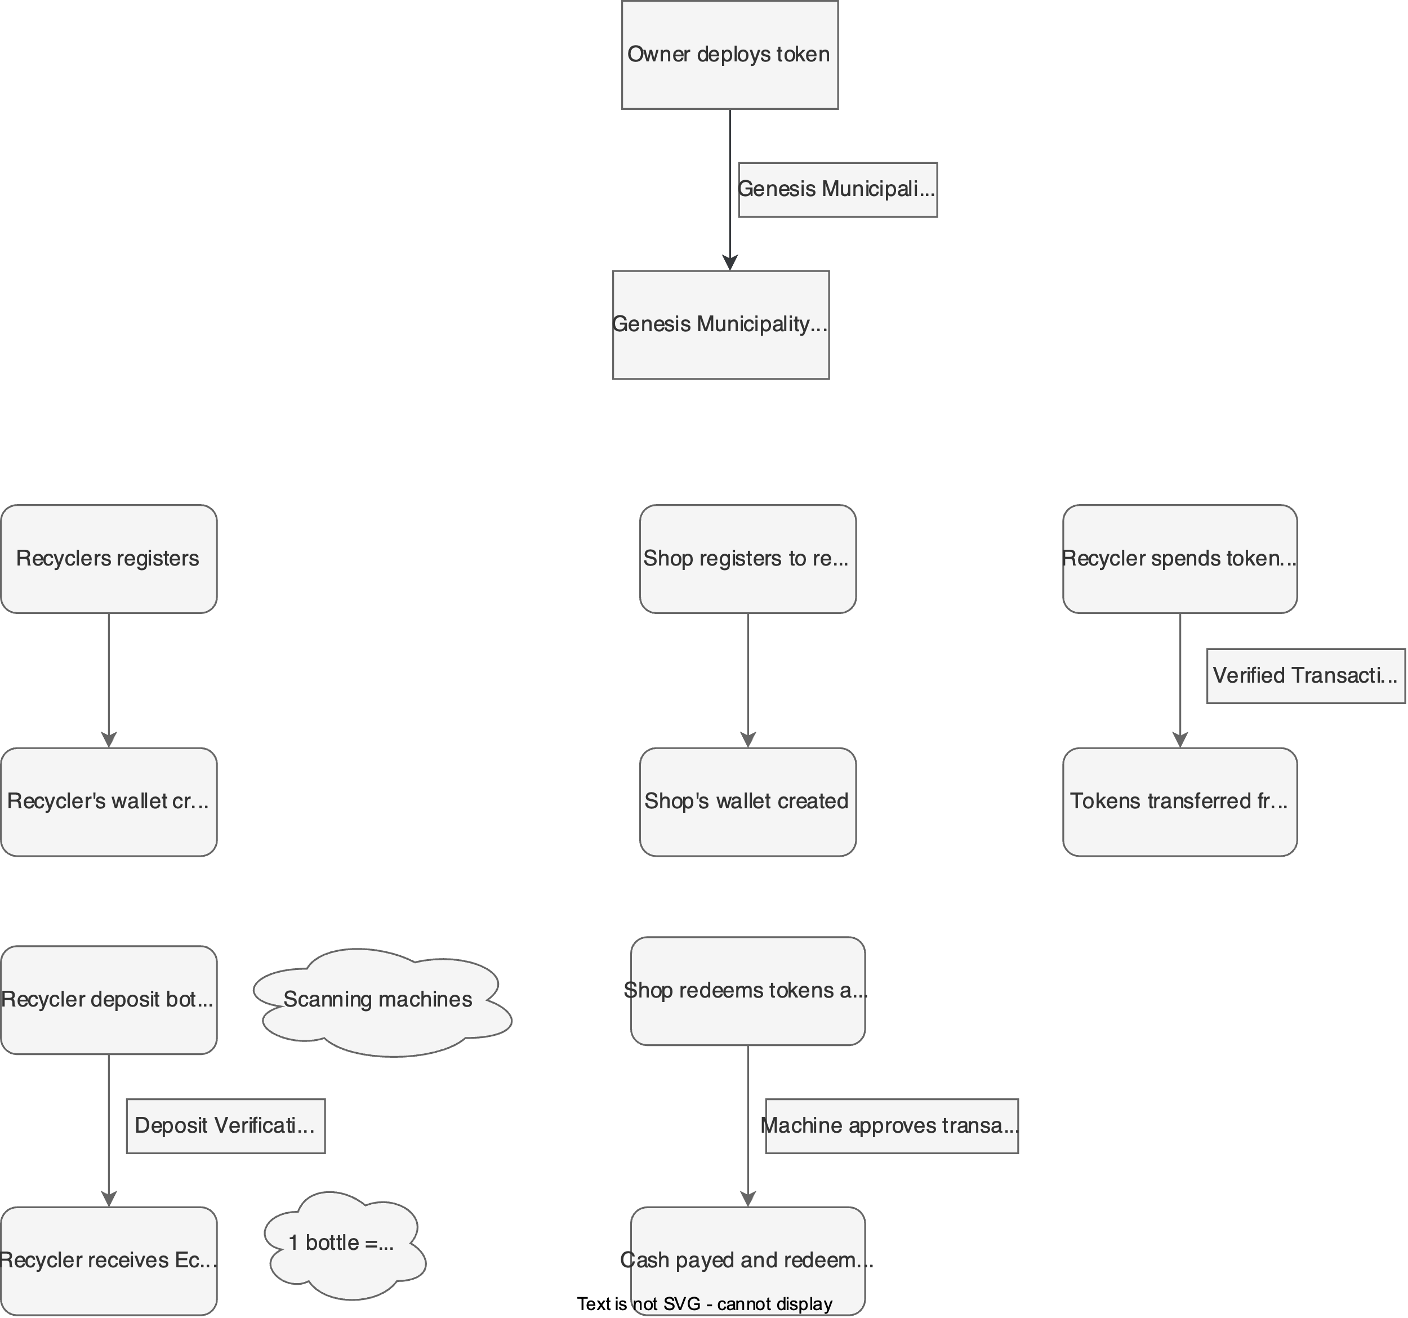
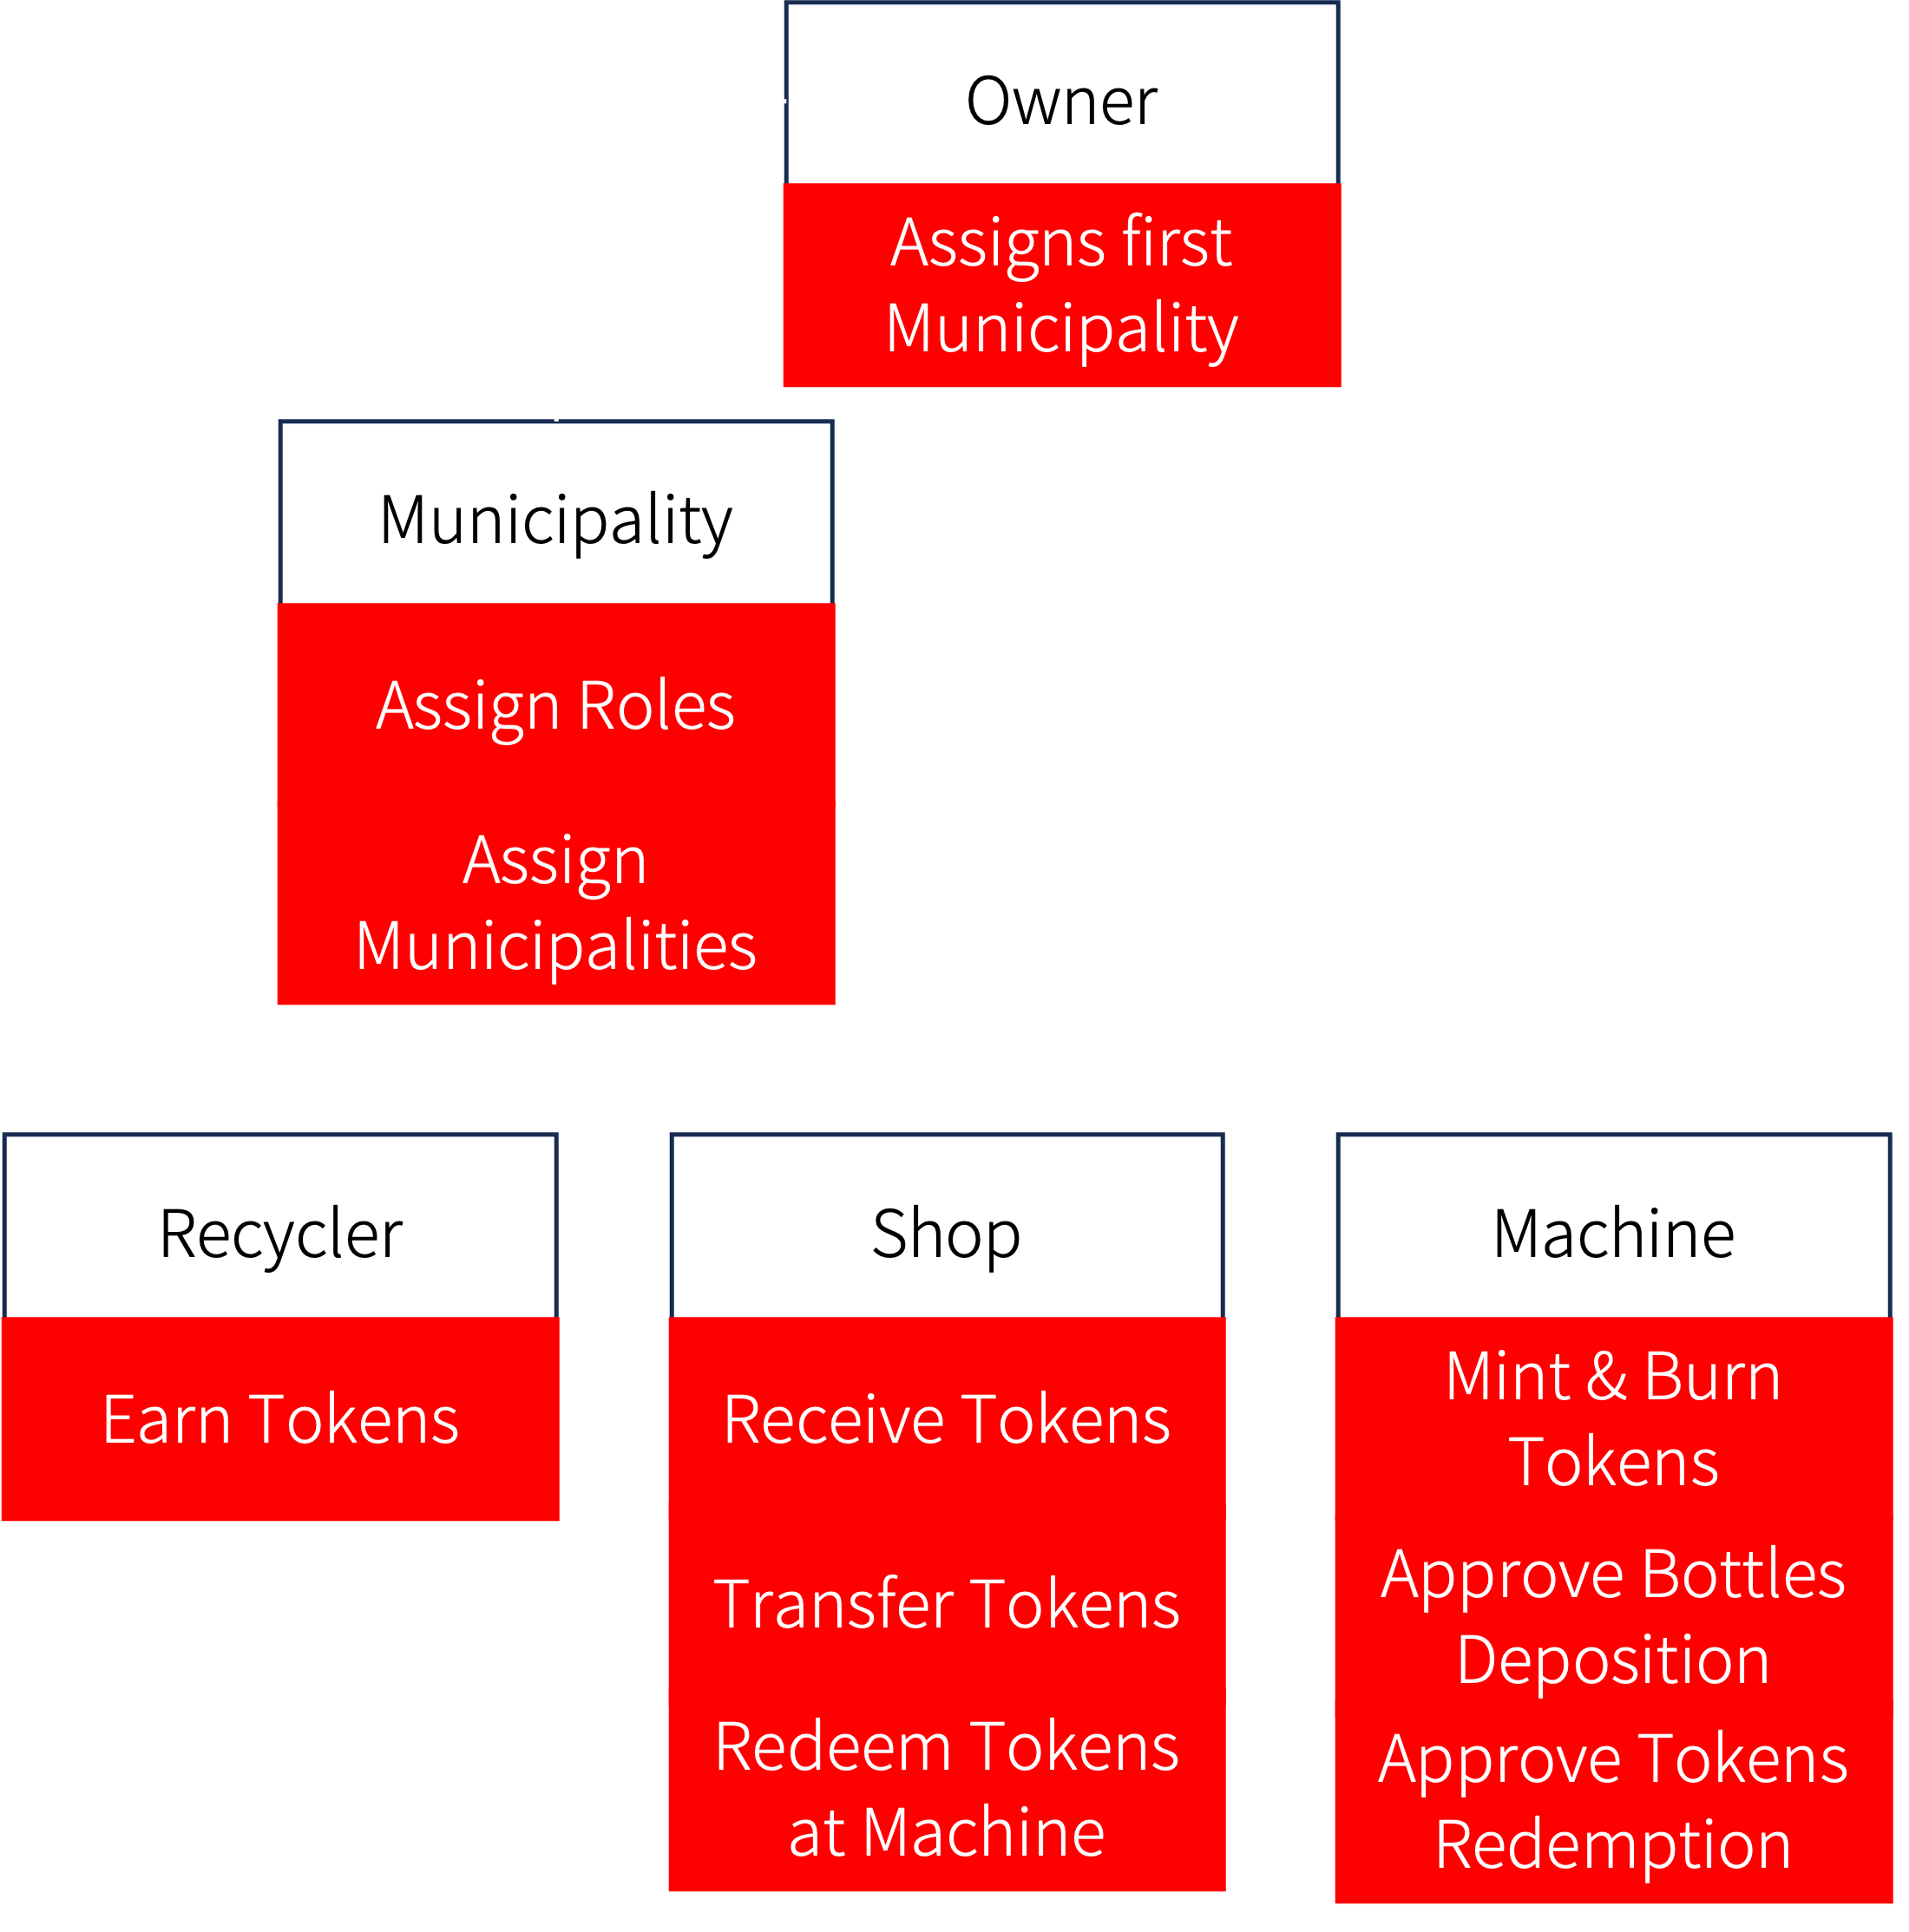
Home
Recycler
Municipality
Shop
Will be scrollable (not side-by-side)
Abstract
Abstract
Abstract

Slide 5
Register
Assign Municipality
Register
Deposit
Register Machine
Redeem
Spend
Approve Shop

Slide 6
Front-End
Register
Assign Municipality
Register
Depositor
Municipality
Shop
Handler
Deposit
Register Machine
Redeem
Machine
Machine
Machine
Spend
Spender
Dropdown menu, shows on hover

Slide 7
Register
Deposit
Spend

Slide 8

Register
Please enter your full name, and connect your Web3 wallet using Google Chrome
Connect Wallet
Full Name
Register

Slide 9
Front-End
Register
Please enter your full name, and connect your Web3 wallet using Google Chrome
Connect Wallet
Text Box (float?)
Web3 Button
Full Name
Text Form
Register
Button
Depositor.sol

Slide 10
Deposit
Please enter the ID of the correct exchange machine you wish to deposit your bottles.
Machine ID
Amount of Bottles
Deposit

Slide 11
Front-End
Deposit
Please enter the ID of the correct exchange machine you wish to deposit your bottles.
Text Box (float?)
Machine ID
Require UINT
Text Form
Amount of Bottles
Require UINT
Text Form
Deposit
Button
Machine.sol

Slide 12
Zip Code
Enter the ID of the shop you wish to spend your tokens, and the amount of tokens needed.
Businesses in 70535:
Café Mosaic – 1
Ruby’s Café – 2
Nick’s on 2nd – 3
The Gentleman’s Barbershop – 4
Reventè – 5
Gossip - 6
Spend
Shop ID
Tokens Amount
Spend

Slide 13
Front-End
Zip Code
JS Text
Enter the ID of the shop you wish to spend your tokens, and the amount of tokens needed.
Businesses in [ZipCode]:
Café Mosaic – 1
Ruby’s Café – 2
Nick’s on 2nd – 3
The Gentleman’s Barbershop – 4
Reventè – 5
Gossip - 6
Spend
Text Box (float?)
Later - make list auto-adjusted from ZipCode
& make box scrollable.
Shop ID
Require UINT
Text Form
Tokens Amount
Require UINT
Text Form
Start with fixed list for presentation
Spend
Button
Spender.sol

Slide 14
Assign Municipality
Register Machine
Approve Shop

Slide 15
Assign Municipality
Please enter the wallet’s address of the new municipality, and its zip code.
Connect Wallet
Municipality Wallet Address
Municipality Zip Code
Assign Municipality

Slide 16
Front-End
Assign Municipality
Please enter the wallet’s address of the new municipality, and its zip code.
Connect Wallet
Text Box (float?)
Web3 Button
Municipality Wallet Address
Require Addr
Text Form
Municipality Zip Code
Require nums (uint) (back-end is string)
Text Form
Assign Municipality
Button
Municipality.sol

Slide 17
Register Machine
Please enter the wallet’s address of the new machine, and its zip code.
Machine Wallet Address
Machine Zip Code
Register Machine

Slide 18
Front-End
Register Machine
Please enter the wallet’s address of the new machine, and its zip code.
Text Box (float?)
Machine Wallet Address
Require Addr
Text Form
Machine Zip Code
Require nums (uint) (back-end is string)
Text Form
Register Machine
Button
Machine.sol

Slide 19
Please enter the ID of the shop as provided to you, and approve / deny the shop’s request.
Approve Shop
Shop ID
Approve / Deny
Approve Shop

Slide 20
Front-End
Please enter the ID of the shop as provided to you, and approve / deny the shop’s request.
Approve Shop
Text Box (float?)
Shop ID
Require UINT
Text Form
Bool –
approve = true;
Deny = false.
Approve / Deny
Text Form
Approve Shop
Button
ShopHandler.sol

Slide 21
Register
Redeem

Slide 22
Register
Enter the shop’s name, type (coffee/clothing/restaurant/etc..) and zip code.
Please note, a municipality’s approval of the registration is required!
Connect Wallet
Shop’s Name
Shop’s Type
Shop’s Zip Code
Request Registration

Slide 23
Front-End
Register
Enter the shop’s name, type (coffee/clothing/restaurant/etc..) and zip code.
Please note, a municipality’s approval of the registration is required!
Connect Wallet
Text Box (float?)
Web3 Button
Shop’s Name
Text Form
Shop’s Type
Text Form
Shop’s Zip Code
Require nums (back-end is string)
Text Form
Request Registration
Button
ShopHandler.sol

Slide 24
Redeem
Please enter the exchange machine’s ID you wish to redeem with, your CashApp’s username to receive real funds, and the amount of tokens you wish to redeem.
Machine ID
CashApp Username
Tokens Amount
Redeem

Slide 25
Front-End
Redeem
Please enter the exchange machine’s ID you wish to redeem with, your CashApp’s username to receive real funds, and the amount of tokens you wish to redeem.
Machine ID
Require UINT
Text Form
CashApp Username
Text Form
Tokens Amount
Require UINT
Text Form
Redeem
Button
Machine.sol

